Slide 1
It is never too early to plan your exit
Rupert Trevelyan
Managing Director
Weybrook Business Brokers
October 2017

Slide 2


Introduction

Slide 3


What would you do?

Slide 4
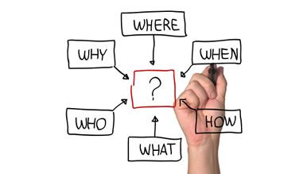
So why do we need to plan?
Most businesses don’t sell
Achieve best price
Business continuity
Achieve clean exit
Avoid pitfalls

Slide 5
The sales funnel
Up to 25% for sale
The majority won’t sell
Source Federation of Small Businesses

Slide 6

Case Study –Pet Supplies
Low profit margins
  Currency fluctuations
  High level of working capital
  High rent
No Succession plan
  No management capability
Keeping the crown jewels
  Best selling product line
  excluded
Solution
Action plan to improve profitability
and management team -
re-market once plan in place.

Slide 7

Exit drivers
Change of lifestyle
Retirement
Realise investment
Pursue other business interests
Red Tape
Unable/ willing to take business to next level

Slide 8

M&A drivers
UK companies braced for 12 months of rampant M&A
Daily Telegraph – 8 May 2017
Synergy
Diversification
Market Entry
Sharpening Business Focus
Growth: Build market share
Increase Supply-Chain Pricing Power
Eliminate Competition

Slide 9

M&A Activity UK

Slide 10

Case Study –Micro Brewery
Respected local brewery
No succession plan
More value in the property than the business
Low ROCE
Owners built their home on the property
Hard physical work
Solution
Separate business from property

Slide 11
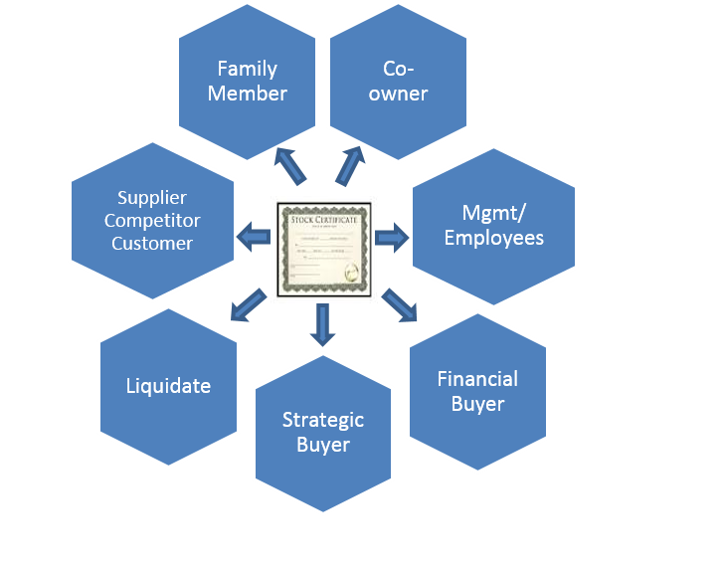

Types of Exit
Exit Plan
IPO

Slide 12

Case Study –Software Supplier
Developed bespoke retail POS system
Worked with major UK retailer who have now developed inhouse solution
Insufficient expertise & finance to take it to the next level
Solution
Found strategic business
partner

Slide 13
Why don’t most businesses sell?
Price / Valuation
Timeframe
Ongoing Viability
  Future value
  Key players team / expertise
Poor Preparation
Marketing
Market
  Brexit
Poor Advice / Exit Planning
Due Diligence
Source Pitchbook September 2017

Slide 14

Case Study – Recruitment Consultants
  Respected industry player
  Senior partner blocked succession plan
  Junior Partner left
    Highest account biller
    Gatekeeper to key accounts
    Followed by execs
  Solution
  The best solution would have been transferring the business to the Junior
  Partner

Slide 15
Get Your House In Order
Plan your exit
Finances
Succession
Build your business
60% of business sales in 2017 were showing 10% Revenue increase in 2016
Get the right advice
Source Pitchbook Global Report September 2017
Multiples in UK are more conservative than the US

Slide 16

Thank you
Rupert@weybrookbusinessbrokers.com
www.weybrookbusinessbrokers.com
07826 050690
Rupert Trevelyan

